Slide 1
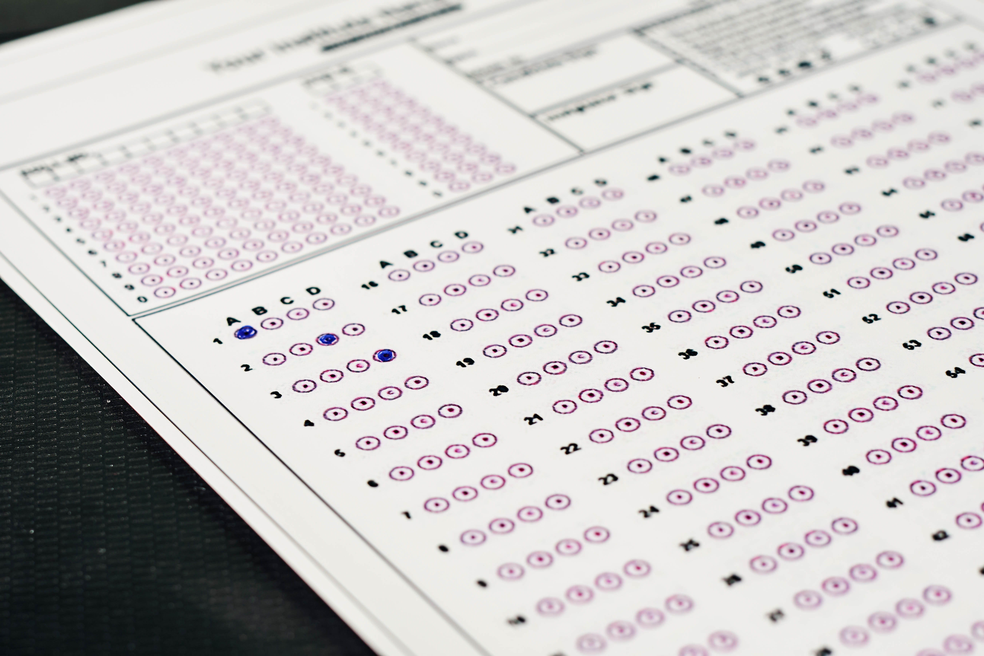
School District Testing Analysis (Mock dataset)
Josh Stephens
Hybrid Analyst
Creative Commons photo: https://www.flickr.com/photos/30478819@N08/51038121971
https://creativecommons.org/licenses/by/2.0/

Slide 2
Overview
District summary
Key observations
Success metrics
Recommended next steps
Dataset analyzed

Slide 3
District Level Summary
Measure | Value
Total high schools | 15
Total students | 39,170
Total budget | $24,649,428
Average math score | 79.0
Average reading score | 81.9
% passing math | 75.0%
% passing reading | 85.8%
% passing both | 65.2%

Slide 4
Key observations
Our charter high schools had consistently higher scores than our traditional high schools
Our charter schools have lower per pupil budgets

Slide 5
Success Metrics
Math
Average score
% passing (≥ 70%)
Reading
Average score
% passing (≥ 70%)
Combined
% passing both

Slide 6
Success Metrics
Performance by
type
spending
size
Additional details in Appendix

Slide 7
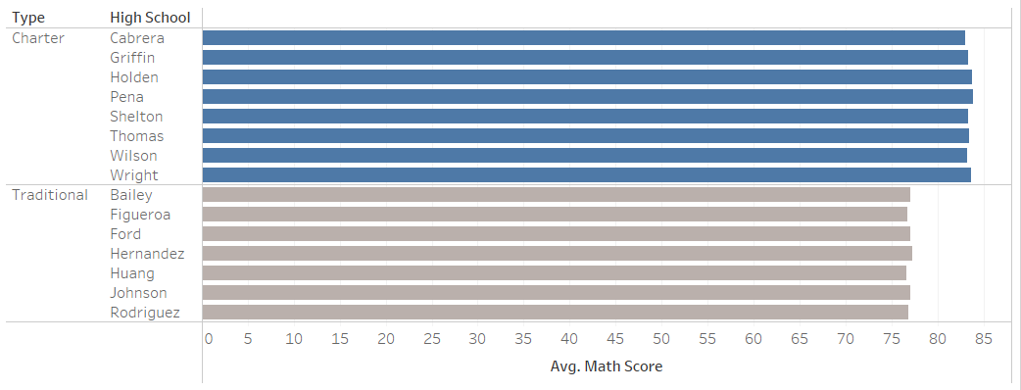
District results – average math score 79
Charter average – 83, Traditional average – 77

Slide 8
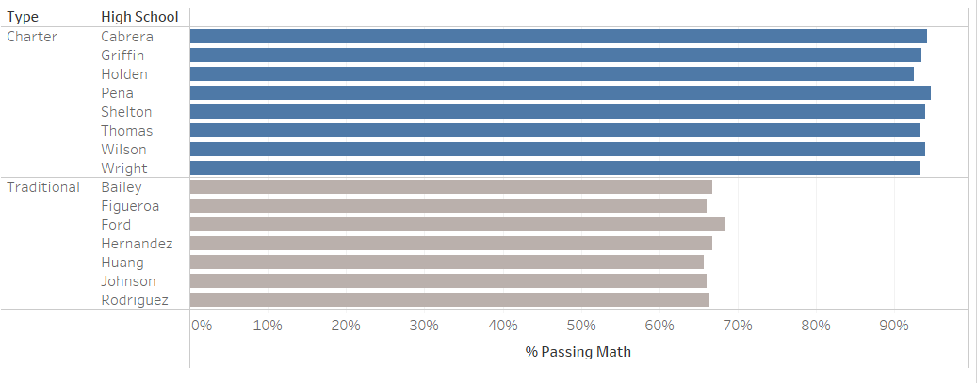
District results – 75% passing math
Charter average – 94%, Traditional average – 67%

Slide 9

District results – average reading score 82
Charter average – 84, Traditional average – 81

Slide 10
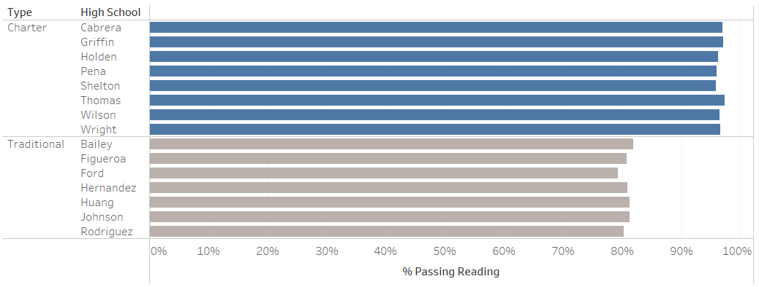
District results – 86% passing reading
Charter average – 97%, Traditional average – 81%

Slide 11
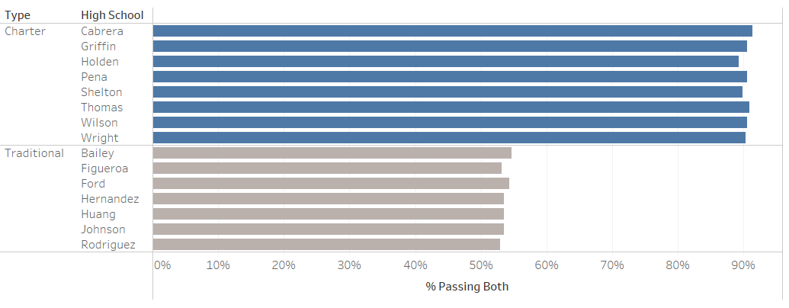
District results – 65% passing both
Charter average – 90%, Traditional average – 54%

Slide 12
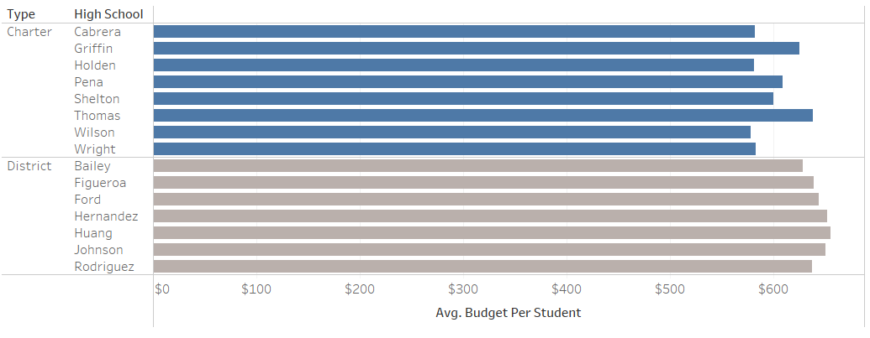
Average budget - $629 per student
Charter average – $599, Traditional average – $643

Slide 13
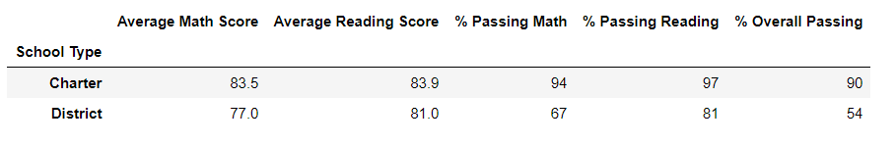
Performance by school type

Slide 14
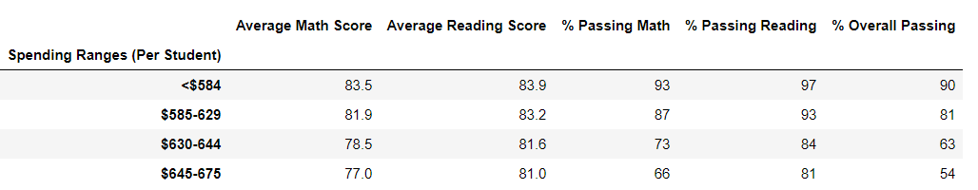
Performance by school spending

Slide 15
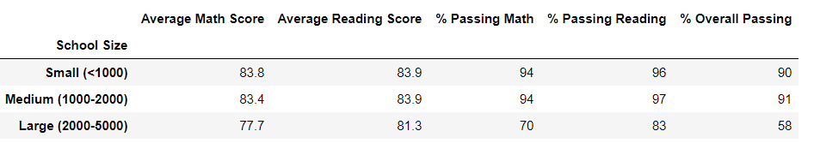
Performance by school size

Slide 16
Recommended Next Steps
Regression analysis
Are differences caused by other variables?
Team to study various approaches and make recommendations for future optimizations

Slide 17
Dataset Analyzed
Student file – 39,170 individual student records
Student ID
Name
Gender
Grade
High School
Reading score
Math score

Slide 18
Dataset Analyzed
School file -15 school records
School ID
Name
Type (charter or traditional)
Student population
Total budget

Slide 19
Dataset Analyzed – school averages
Type | # | Avg # of students | Avg budget | Avg per pupil budget
Charter | 8 | 1,500 | $910,000 | $600
Traditional | 7 | 3,900 | $2,480,000 | $644
Total | 15 | 2,600 | $1,640,000 | $620

Slide 20
Analysis project
Aggregation of data to get success metrics
Joining of files to get type/school performance, budget summaries

Slide 21
Overview
District summary
Key observations
Success metrics
Recommended next steps
Dataset analyzed

Slide 22

Open floor for questions & observations
Photo by Nguyen Dang Hoang Nhu on Unsplash

Slide 23
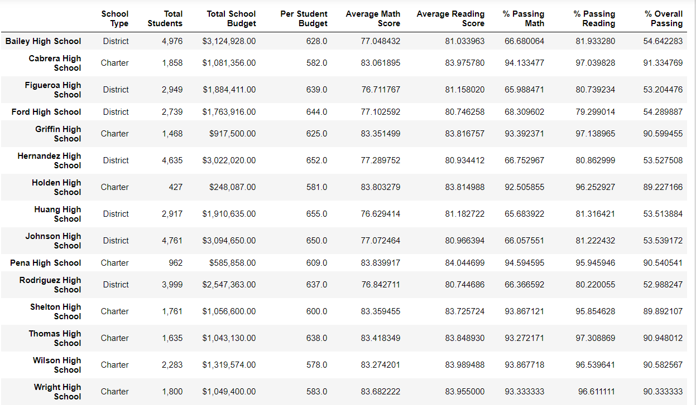
Individual school details

Slide 24
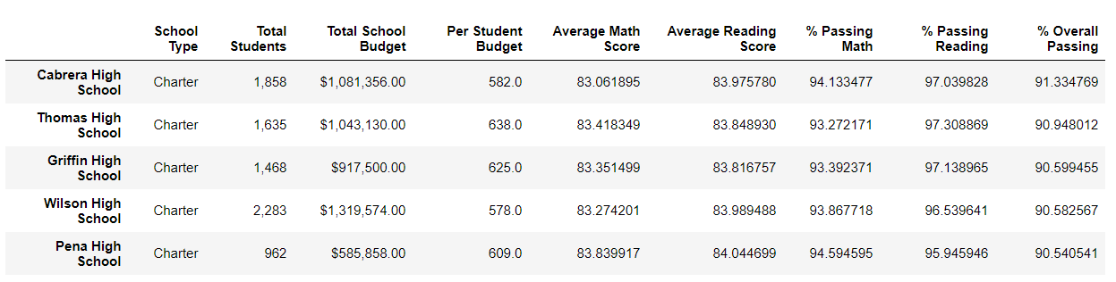
Top schools (overall % passing)

Slide 25
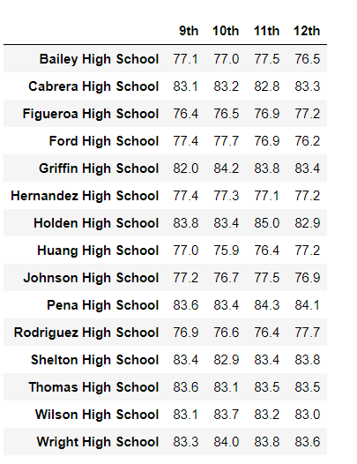
Math scores by grade

Slide 26
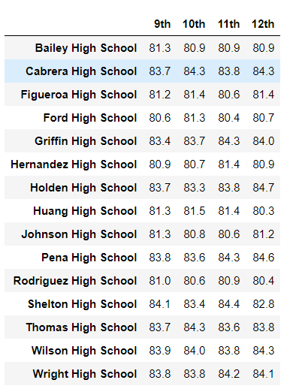
Reading scores by grade

